Slide 1
Lesson 15: The Good Samaritan and the Feast of Dedication
The Parable of Good Samaritan (Luke 10:25-37)
May 26, 2021

Slide 2
Jesus’ Answer to the Question
Luke 10:29, “But he, desiring to justify himself, said unto Jesus, And who is my neighbor?”
The lawyer desired to appear blameless, to vindicate himself, and show that he had kept the law.
The Pharisees believed that the Jews only were to be regarded as neighbors, and that their obligation to “love thy neighbor” did not extend at all. (cf. Leviticus 19:18; Matthew 5:43-48)
Passages regarding “respect of persons.”
2 Chronicles 19:7; Proverbs 24:23; 28:21; Acts 10:34-45; Romans 2:1-11; James 2:1ff; 1 Peter 1:17

Slide 3
Jesus’ Answer to the Question
Luke 10:30, “Jesus made answer and said, A certain man was going down from Jerusalem to Jericho; and he fell among robbers, who both stripped him and beat him, and departed, leaving him half dead. And by chance a certain priest was going down that way: and when he saw him, he passed by on the other side. And in like manner a Levite also, when he came to the place, and saw him, passed by on the other side. But a certain Samaritan, as he journeyed, came where he was: and when he saw him, he was moved with compassion, and came to him, and bound up his wounds, pouring on (them) oil and wine; and he set him on his own beast, and brought him to an inn, and took care of him. And on the morrow he took out two shillings, and gave them to the host, and said, Take care of him; and whatsoever thou spendest more, I, when I come back again, will repay thee.36 Which of these three, thinkest thou, proved neighbor unto him that fell among the robbers? And he said, He that showed mercy on him. And Jesus said unto him, Go, and do thou likewise.”

Slide 4
Jesus’ Answer to the Question
History of the Samaritans.
Luke 9:51-55; 2 Kings 17:24-29; Ezra 4:1-3; and Nehemiah 4:7
Samaritans were despised.
They had a different place of worship. John 4
Many were of mixed ancestry and thus not pure Israelites in their blood lines.
Religious and political loyalties were not always orthodox.
Jews linked the term “Samaritan” with having a “demon” John 8:48-49.
Though the Samaritans could travel in the land of the Jews, they were not welcomed.

Slide 5
Jesus’ Answer to the Question
The Victim. Luke 10:30
“A certain man”
Jesus frequently used this expression. Luke 12:16; 13:6; 14:16; 15:11; 16:1,19; 18:2; 19:12
“He fell among robbers, who both stripped him and beat him, and departed, leaving him half dead.”

Slide 6
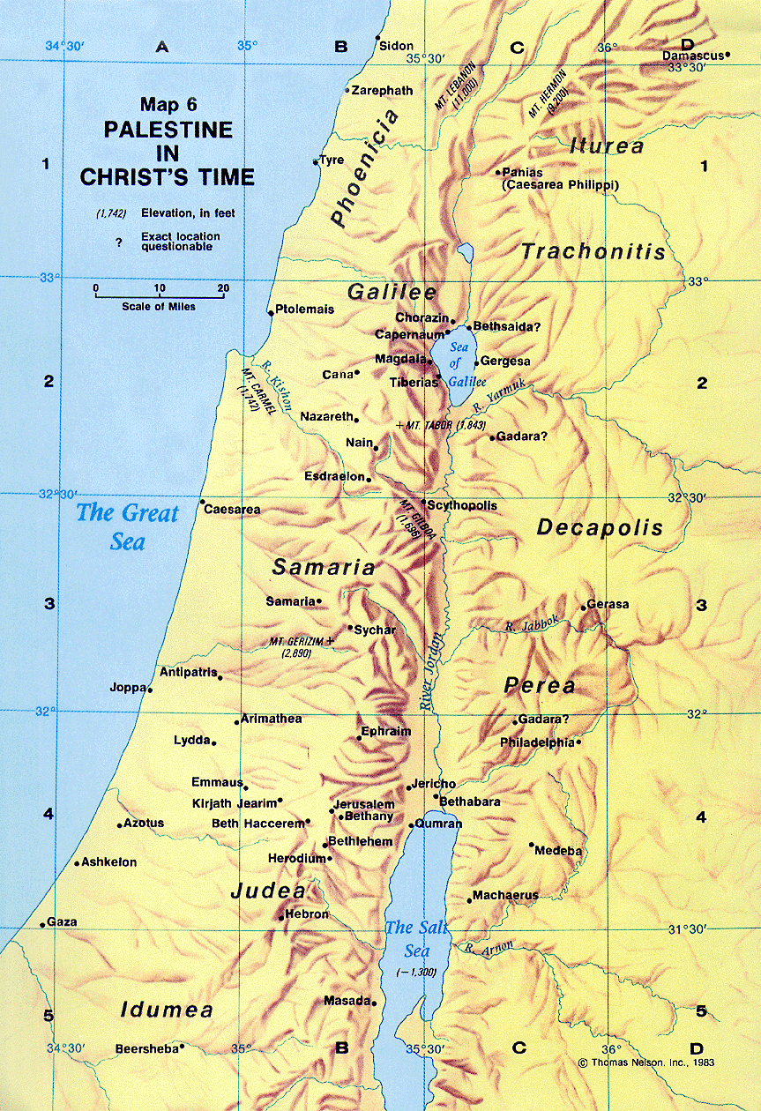
Jesus’ Answer to the Question
The Place. “from Jerusalem to Jericho”
Jerusalem (about 2,700 feet above sea level) was approximately thirty-five hundred feet higher than Jericho (about 850 feet below sea level);
Jericho was sometimes called the “city of palm trees” (Deuteronomy 34:3; Judges 1:16; 2 Chronicles 28:15).
17 Miles

Slide 7
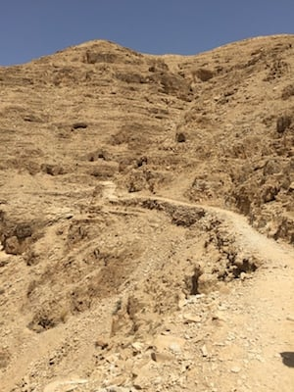
Jesus’ Answer to the Question
The Place. “from Jerusalem to Jericho”

Slide 8
Jesus’ Answer to the Question
The Priest. Luke 10:31, “And by chance a certain priest was going down that way: and when he saw him, he passed by on the other side.”
Supposedly a holy, spiritual, religious man entrusted with illustrating righteousness. cf. Deuteronomy 22:1-4.
The Levite. Luke 10:32, “And in like manner a Levite also, when he came to the place, and saw him, passed by on the other side.”
The Levites, as well as the priests, were of the tribe of Levi, and were set apart to the duties of religion.
Micah 6:8, “He hath showed thee, O man, what is good; and what doth Jehovah require of thee, but to do justly, and to love kindness, and to walk humbly with thy God?”

Slide 9
Jesus’ Answer to the Question
The Samaritan. Luke 10:33, “But a certain Samaritan, as he journeyed, came where he was: and when he saw him, he was moved with compassion …”
cf. Matthew 9:36; Luke 7:13 – “Compassion (esplagchnisthē), is to “feel sympathy” or be moved with pity (Arndt and Gingrich, Page 770).

Slide 10
Jesus’ Answer to the Question
The Samaritan. Luke 10:34, “and came to him, and bound up his wounds, pouring on (them) oil and wine; and he set him on his own beast, and brought him to an inn, and took care of him.”
This is “how Christians should handle racial, national, ethnic, and even religious differences when basic human kindness is required. Love must not be denied or abandoned, even in the face of differences. To do so denies the love of God.”
(C.G. Caldwell, Luke, Truth Commentaries, page 636)
The Samaritan spent time with the injured/robbed man.

Slide 11
Jesus’ Answer to the Question
The Samaritan. Luke 10:35, “And on the morrow he took out two shillings, and gave them to the host, and said, Take care of him; and whatsoever thou spendest more, I, when I come back again, will repay thee.”
Two shillings (pence, dēnaria) – The equivalent of two days’ wages. cf. Matthew 20:9
Several days at the inn.
Note the care of the innkeeper.

Slide 12
Jesus’ question to the Lawyer
Luke 10:36, “Which of these three, thinkest thou, proved neighbor unto him that fell among the robbers?”
Now the Lawyer would have to answer his own question.
Luke 10:25, “Teacher, what shall I do to inherit eternal life?”
Luke 10:27-29, “And who is my neighbor?”
Note: He does not actually say, “The Samaritan.”

Slide 13
Jesus’ instruction to the Lawyer
Luke 10:25, “Teacher, what shall I do to inherit eternal life?”… cf. verse 37, “And he said, He that showed mercy on him. And Jesus said unto him, Go, and do thou likewise.”
The Lawyer, would have to go and do what a Samaritan had done!
Mercy is undeserved. There is no acceptable human, earthly explanation for such love from a materialistic perspective. It comes from a good heart filled with love.

